Slide 1
N-Grams

Slide 2
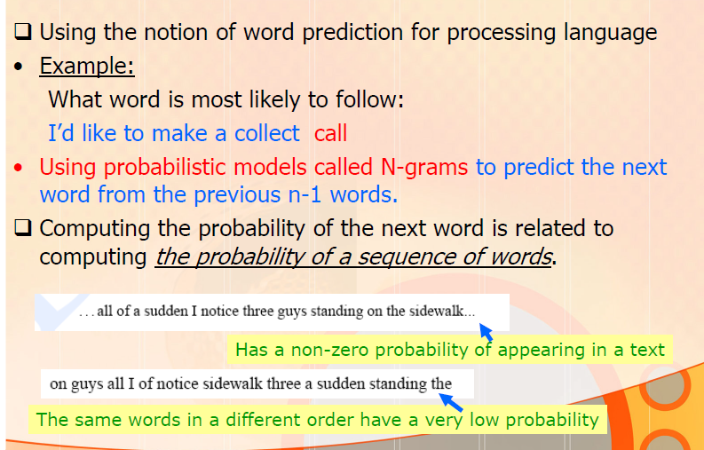
N-Grams
Ex: “Tomorrow there will be no …”

Slide 3
N-Grams
Word Prediction: Guess the next word...
... I notice three guys standing on the ???
There are many sources of knowledge that can be used
to inform this task, including arbitrary world knowledge.
But we can look at the preceding words and keep track of some simple counts.
An N-gram is an N-token sequence of words
A 2-gram called bigram is a 2-word sequence of words
Ex: your homework
A 3-gram called trigram is a 3-word sequence of words
Ex: turn your homework
A N-gram model is a model which computes the last word of a N-gram from the previous ones. (both N-gram and N-gram model is used in the same way)
Such statistical models of word sequences are also called language models or LMs.

Slide 4
N -GRAMS
An N-gram model uses the previous N-1 words to predict the next one:
P(w_{n} | w_{n -1})
Dealing with P(<word> | <some prefix>)
unigrams: P(student)
bigrams: P(student | clever)
trigrams: P(student | the clever)
quadrigrams: P(student | the clever honest)

Slide 5
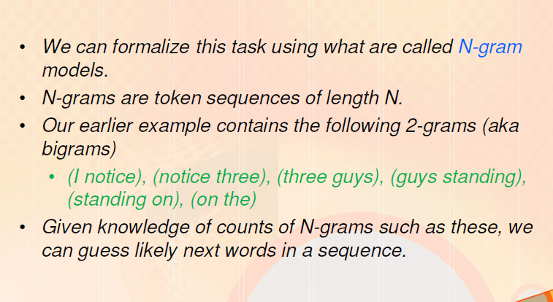
N-Grams
Word Prediction
Ex: ... I notice three guys standing on the ???

Slide 6
N-Gram Models
Formally
estimators like N-grams that assign a conditional probability to possible next words
can be used to assign a joint probability to an entire sentence.
we can use knowledge of the counts of N grams to assess the conditional probability of candidate words as the next word in a sequence.
Or, we can use them to assess the probability of an entire sequence of words.

Slide 7
Applications
Being able to predict the next word (or any linguistic unit) in a sequence is an extremely useful thing
• Applications
• Automatic Speech Recognition (ASR)
• Handwriting and character recognition
• Spelling correction
• Machine translation
N-grams are also crucial in NLP tasks
part-of-speech tagging,
natural language generation
word similarity
authorship identification
sentiment extraction
predictive text input systems for cell phones

Slide 8
Applications
• Applications
• Automatic Speech Recognition (ASR)
N-grams are essential in any task in which we have to identify words in noisy, ambiguous input.
In speech recognition, the input speech sounds are very confusable and many words sound extremely similar
Example from speech recognition:
it drank two beers
it drank too beers
it drank too deers

Slide 9
Applications
Applications
• Spelling correction
In spelling correction, we need to find and correct spelling errors that accidentally result in real English words:
They are leaving in about fifteen minuets to go to her house.
The design an construction of the system will take more than a year.
Since these errors have real words
we can not find them by just flagging words that are not in the dictionary.
But note that in about fifteen minuets is a much less probable sequence than in about fifteen minutes .
A spellchecker can use a probability estimator both to detect these errors and to suggest higher-probability corrections

Slide 10
Real-Word Spelling Errors
Words that sound the same –
Their/they’re/there
To/too/two
Weather/whether
Peace/piece
You’re/your
• Typos that result in real words
Collect a set of common pairs of confusions
• Whenever a member of this set is encountered compute the probability of the sentence in which it appears
• Substitute the other possibilities and compute the probability of the resulting sentence
• Choose the higher one

Slide 11
Applications
• Applications
• Machine translation
Ex: From Chinese source sentence to a set of potential English translations:
he briefed to reporters on the chief contents of the statement
he briefed reporters on the chief contents of the statement
he briefed to reporters on the main contents of the statement
he briefed reporters on the main contents of the statement
An N-gram grammar might tell that
briefed reporters is more likely than briefed to reporters, and
main contents is more likely than chief contents.
So lets us select the bold-faced sentence above as the most fluent translation sentence, i.e. the one that has the highest probability

Slide 12
Applications
Applications: Word prediction is also important for
Augmentative communication systems that help the disabled.
People who are unable to use speech or sign-language to communicate, like the physicist Steven Hawking
can communicate by using simple body movements
to select words from a menu that are spoken by the system.
Word prediction can be used to suggest likely words for the menu.

Slide 13
Corpora
Corpora are (plural of corpus is corpora , generally online) collections of text and speech
Ex:
Brown Corpus (1M words)
Wall Street Journal and AP News corpora
ATIS, Broadcast News (speech)
TDT (text and speech)
Switchboard, Call Home (speech)
TRAINS, FM Radio (speech)

Slide 14
Word Counting in Corpora
Counting: Probabilities are based on counting things.
Counting of things in natural language is based on a corpus (plural corpora), an on-line collection of text or speech.
look at two popular corpora, Brown and Switchboard.
The Brown corpus
a 1 million word collection of samples
from 500 written texts
from different genres (newspaper, novels, non-fiction, academic, etc.), assembled at Brown University in 1963-64
How many words are in the following Brown sentence?
Ex: He stepped out into the hall, was delighted to encounter a water brother.
• 13 tokens, 15 if we include “,” and “.” as separate tokens.
• Assuming we include the comma and period, how many bigrams are there?

Slide 15
Word Counting in Corpora
Counting: treating period (“ .”), comma (“ ,”), and so on as words depends on the task.
Punctuation is critical for
finding boundaries of things (commas, periods, colons), and
for identifying some aspects of meaning (question marks, exclamation marks, quotation marks).
For tasks, like part-of-speech tagging or parsing or speech synthesis,
we treat punctuation marks as if they were separate words.

Slide 16
Word Counting in Corpora
Counting: The Switchboard corpus
The Switchboard corpus of telephone conversations between strangers was collected in the early 1990s
contains 2430 conversations averaging 6 minutes each
totaling 240 hours of speech and
about 3 million words (Godfrey et al., 1992).
Such corpora of spoken language
do not have punctuation
but do introduce other complications with regard to defining words.
look at one utterance from Switchboard; an utterance is the spoken correlate of a sentence:
I do uh main- mainly business data processing
Note: This utterance has two kinds of disfluencies - fragment and fillers
The broken-off word main- is called a fragment.
Words like uh and um are called fillers or filled pauses .
If we are building an automatic dictation system based on automatic speech recognition, we might want to eventually strip out the disfluencies.

Slide 17
Word Counting in Corpora
Counting: Not always that simple
• I do uh main- mainly business data processing
• Spoken language poses various challenges.
• Should we count “uh” and other fillers as tokens?
• What about the repetition of “mainly”? Should such do overs
count twice or just once?
• The answers depend on the application.
• If we are focusing on something like ASR to support indexing for search, then “uh” is not helpful (it’s not likely to occur as a query).
• But filled pauses are very useful in dialog management, so we
might want them there.
Note: But we keep disfluencies
How disfluent a person is can be used to identify them or
to detect whether they are stressed or confused
Stolcke and Shriberg (1996) found that treating uh as a word improves next-word prediction (why might this be?)
most speech recognition systems treat uh and um as words.

Slide 18
Word Counting in Corpora
Counting: Not always that simple
Are capitalized tokens and uncapitalized tokens are the same word?
Ex: They and they
These are combined together in speech recognition
while for part-of-speech-tagging capitalization is retained as a separate feature.
Note: We will assume our models are not case-sensitive.

Slide 19
Word Counting in Corpora
Counting : Inflected forms
Should “cats” and “cat” count as the same when we are counting?
These two words have the same lemma cat but are different wordforms.
How about “geese” and “goose”?
Some terminology:
Lemma: a set of lexical forms having the same stem
The wordform is the full inflected or derived form of the word.
N-grams for speech recognition in English are based on wordform
Note: For morphologically complex languages like Arabic we need to deal with lemmati-zation.

Slide 20
Terminology
Sentence: unit of written language
Utterance: unit of spoken language
Wordform: the inflected form that appears in the corpus
Lemma: lexical forms having the same stem, part of speech, and word sense
Types: number of distinct words in a corpus (vocabulary size V = number of distinct words in a corpus )
Tokens: total number of running words N

Slide 21
Word Counting in Corpora
Counting: Not always that simple
N-gram models and counting words in general
requires tokenization or text normalization
separating out punctuation,
dealing with abbreviations like m.p.h.,
normalizing spelling, and so on.

Slide 22
Word Counting in Corpora
Counting: Types and Tokens
How many words are there in English?
To answer this question
we need to distinguish types, the number of distinct words in a corpus or vocabulary size V
from tokens, the total number N of running words.
The following Brown sentence:
They picnicked by the pool, then lay back on the grass
and looked at the stars.
has 16 tokens and 2 punctuations (18 tokens by counting punctuation)
14 types (not counting punctuation)
note that “the” is used 3 times, so there are only 14 unique types (as opposed to tokens).
Note: We focus on counting both types and tokens of N-grams

Slide 23
Word Counting in Corpora
The Switchboard corpus has about 20,000 wordform types (from about 3 million wordform tokens)
Shakespeare's complete works have 29,066 wordform types (from 884,647 wordform tokens)
The Brown corpus has 61,805 wordform types from 37,851 lemma types (from 1 million wordform tokens).
Dictionaries can help in giving lemma counts;
dictionary entries, or boldface forms are a rough upper bound on the number of lemmas (some lemmas have multiple boldface forms).
The American Heritage Dictionary lists 200,000 boldface forms.
The larger corpora we look at, the more word types we find.

Slide 24
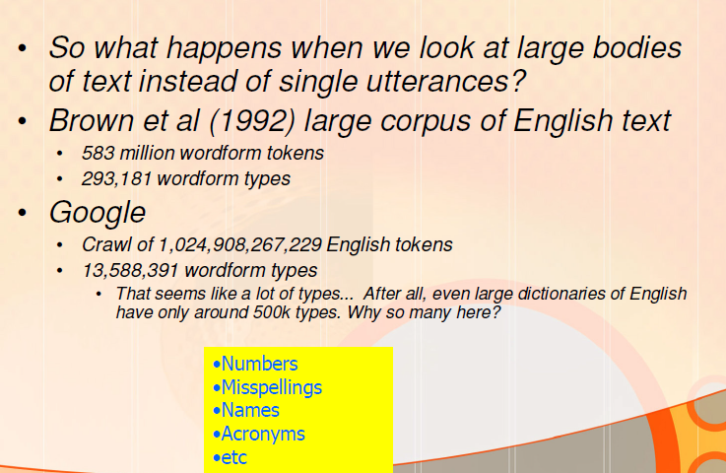
Word Counting in Corpora

Slide 25
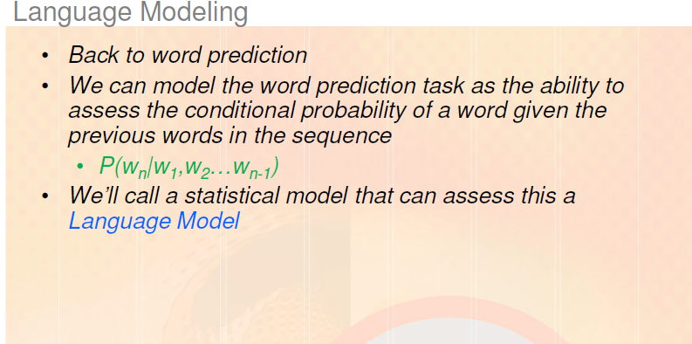
SIMPLE (UNSMOOTHED) N -GRAMS

Slide 26
SIMPLE (UNSMOOTHED) N -GRAMS
Ways to assign probabilities to strings of words:
for giving a probabilistic prediction of what the next word will be in a sequence or
for computing the probability of an entire sentence

Slide 27
SIMPLE (UNSMOOTHED) N -GRAMS
The simplest possible model of word sequences:
let any word of the language follow any other word.
The probabilistic version of this theory:
every word will have an equal probability of following every other word.
English language
If English had 100,000 words
the probability of any word following any other word would be 1/1,00,000 = 0.00001.

Slide 28
SIMPLE (UNSMOOTHED) N -GRAMS
More complex model of word sequences:
Any word could follow any other word, but the following word would appear with its normal frequency of occurrence.
Ex: word the has a high relative frequency
it occurs 69,971 times in the Brown corpus of 10, 00,000 words
i.e. 7% (69,971/ 10,00,000 = 0.069971‬ = 7%) of the words in this particular corpus are the
the word rabbit occurs only 11 times in the Brown corpus

Slide 29
SIMPLE (UNSMOOTHED) N -GRAMS
How can we use these relative frequencies to assign a probability distribution across following words?
Ex: if we have just seen the string Anyhow,
we can use the probability 0.07 for the and
.00001 for rabbit to guess the next word
But suppose we have just seen the following string: Just then, the white
In this context rabbit seems like a more reasonable word to follow white than the does.
This suggests that instead of just looking at the individual relative frequencies of words
we should look at the conditional probability of a word given the previous words.
That is, the probability of seeing rabbit given that we just saw white represented as P(rabbit | white)) is higher than the probability of rabbit P(rabbit).

Slide 30
SIMPLE (UNSMOOTHED) N -GRAMS
An N-gram model uses the previous N-1 words to predict the next one:
P(w_{n} | w_{n -1})
Dealing with P(<word> | <some prefix>)
unigrams: P(student)
bigrams: P(student | clever)
trigrams: P(student | the clever)
quadrigrams: P(student | the clever honest)

Slide 31
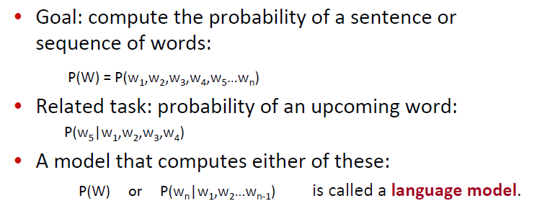
Probabilistic Language Modeling – Summary

Slide 32
SIMPLE (UNSMOOTHED) N -GRAMS
Goal: Compute the probability of a word w given some history h, or P(w|h)
Ex: history h is “its water is so transparent that”
we want to know the probability that the next word is the
P(the|its water is so transparent that)
How can we compute this probability?
One way :
estimate it from relative frequency counts.
Ex: take a very large corpus,
count the number of times we see the water is so transparent that, and count the number of times this is followed by the.
So answer the question “Out of the times we saw the history h, how many times was it followed by the word w”, as follows:

Slide 33
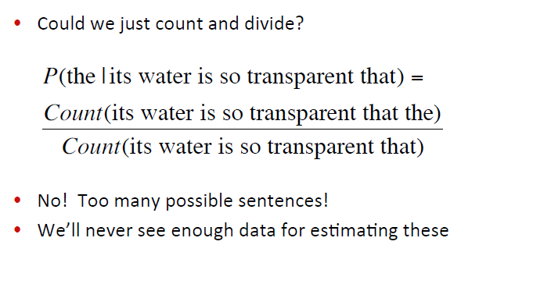
SIMPLE (UNSMOOTHED) N -GRAMS
Goal: Compute the probability of a word w given some history h, or P(w|h)

Slide 34
SIMPLE (UNSMOOTHED) N -GRAMS
Goal: Similarly, compute the joint probability of an entire sequence of words
Ex: its water is so transparent
we could do it by asking “out of all possible sequences of 5 words, how many of them are its water is so transparent?”
We would have to get the count of its water is so transparent, and divide by the sum of the counts of all possible 5 word sequences.
Disadv: a lot to estimate

Slide 35
SIMPLE (UNSMOOTHED) N -GRAMS
Introduce cleverer ways of estimating the probability:
Compute the probability of a word w given some history h, P(w|h) or
the probability of an entire word sequence W
Formalizing of notation:
represent the probability of a random variable Xi taking on the value “the”, or P(Xi = “the”), use the simplification P(the)
represent a sequence of N words either as w1 . . .wn or w1^{n}
the joint probability of each word in a sequence having a particular value P(X = w1,Y = w2 , Z = w3 , ..., ) use P(w1, w2 , ..., wn).
To compute probabilities of entire sequences like P(w1, w2 , ..., wn)
Decompose this probability using the chain rule of probability:

Slide 36
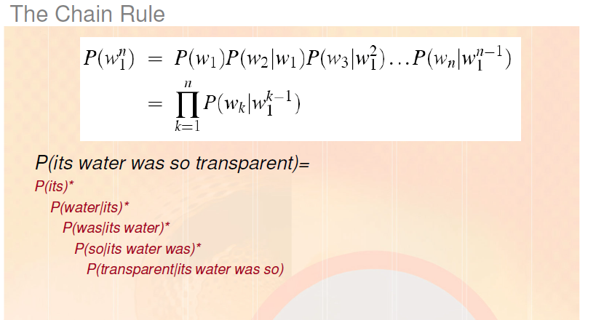
SIMPLE (UNSMOOTHED) N -GRAMS
P(w1, w2 , ..., wn)

Slide 37
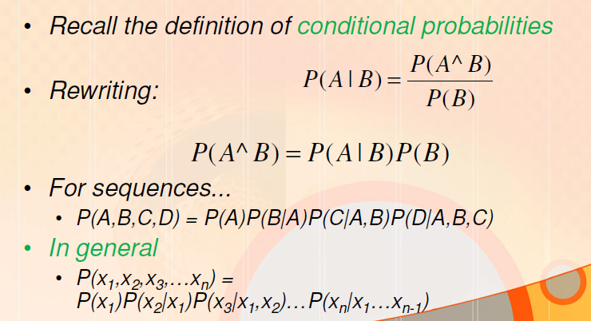
SIMPLE (UNSMOOTHED) N -GRAMS

Slide 38
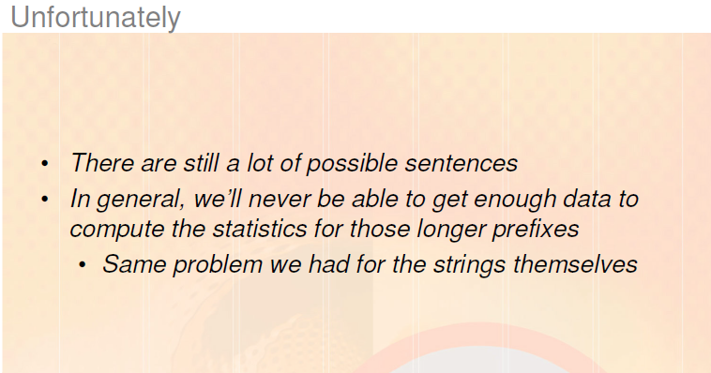
SIMPLE (UNSMOOTHED) N -GRAMS

Slide 39
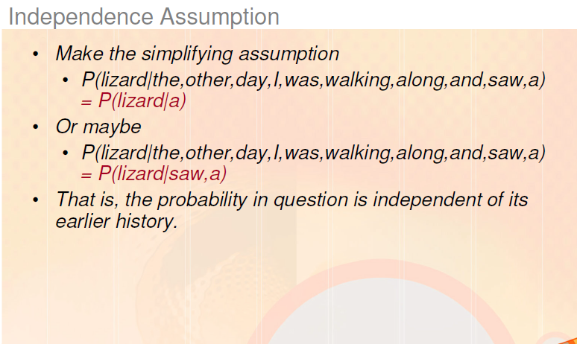
SIMPLE (UNSMOOTHED) N -GRAMS

Slide 40
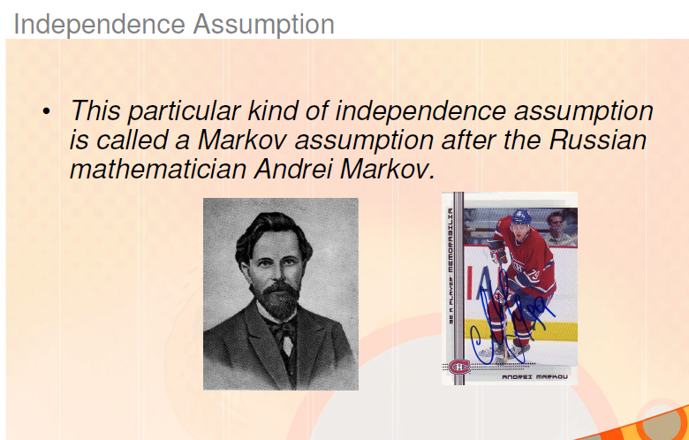
SIMPLE (UNSMOOTHED) N -GRAMS

Slide 41
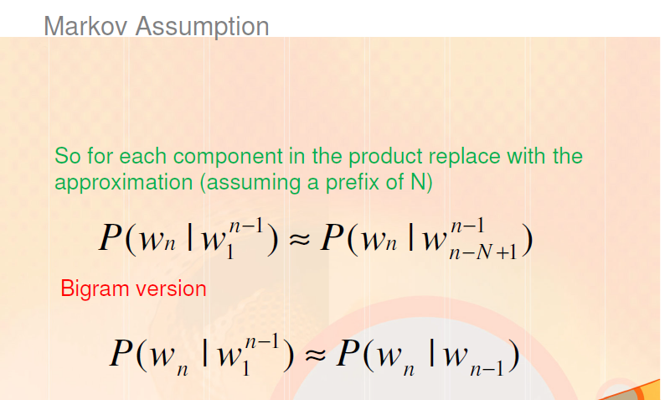
SIMPLE (UNSMOOTHED) N -GRAMS

Slide 42
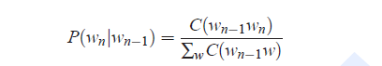
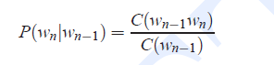
SIMPLE (UNSMOOTHED) N -GRAMS
To compute a bigram probability of a word y given a previous word x,
compute the count of the bigram C(xy) and normalize by the sum of all the bigrams that share the same first word x:
Simplifying this equation:
since the sum of all bigram counts that start with a given word wn−1 must be equal to the unigram count for that word wn−1.

Slide 43
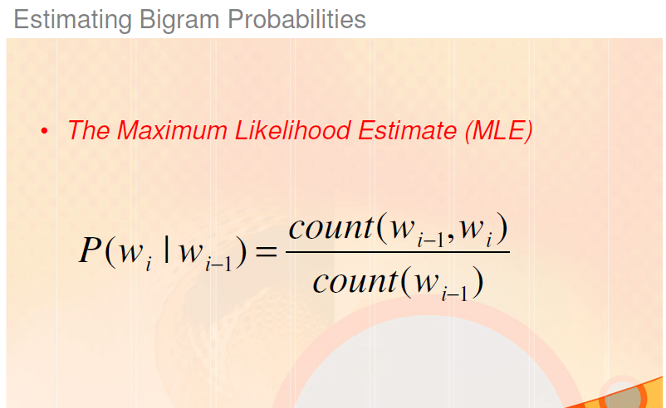
SIMPLE (UNSMOOTHED) N -GRAMS

Slide 44
SIMPLE (UNSMOOTHED) N -GRAMS
Example: a mini-corpus of three sentences.
Augment each sentence with a special symbol <s> at the beginning of the sentence to give the bigram context of the first word.
Need a special end-symbol </s>
<s> I am Sam </s>
<s> Sam I am </s>
<s> I do not like green eggs and ham </s>
Calculate following bigram probabilities from this corpus
P(I|<s>) P(Sam|<s>) P(am|I) P(</s>|Sam) P(Sam|am) P(do|I)

Slide 45
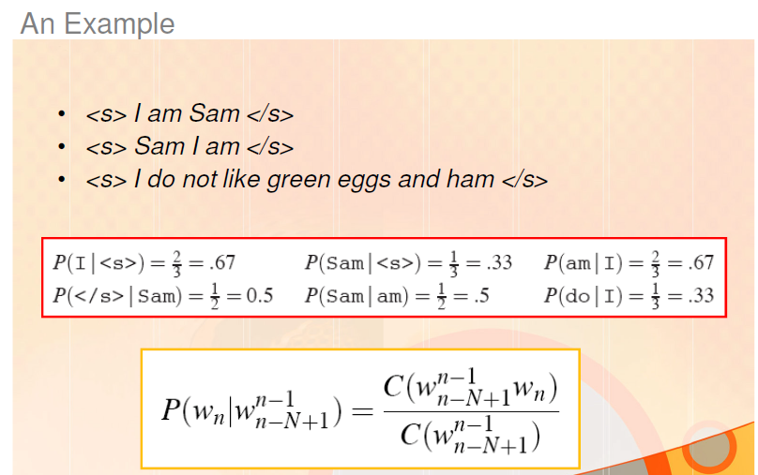
SIMPLE (UNSMOOTHED) N -GRAMS

Slide 46
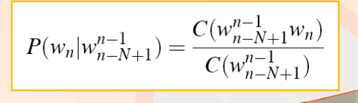
SIMPLE (UNSMOOTHED) N -GRAMS
The general case of MLE N-gram parameter estimation:
Equation estimates the N-gram probability by
dividing the observed frequency of a particular sequence by the observed frequency of a prefix.
This ratio is called a relative frequency.
use of relative frequencies as a way to estimate probabilities is an example of Maximum Likelihood Estimation or MLE.
In Maximum Likelihood Estimation, the resulting parameter set maximizes the likelihood of the training set T given the model M (i.e., P(T|M)).

Slide 47
SIMPLE (UNSMOOTHED) N -GRAMS
Ex: suppose the word Chinese occurs 400 times in a corpus of a million words like the Brown corpus.
What is the probability that a random word selected from some other text of say a million words will be the word Chinese?
The MLE estimate of its probability is 400/1000000 or .0004. Now .0004 is not the best possible estimate of the probability of Chinese occurring in all situations;
it might turn out that in some OTHER corpus or context Chinese is a very unlikely word.
But it is the probability that makes it most likely that Chinese will occur 400 times in a million-word corpus.
Note: There are ways to modify the MLE estimates to get better probability estimates

Slide 48
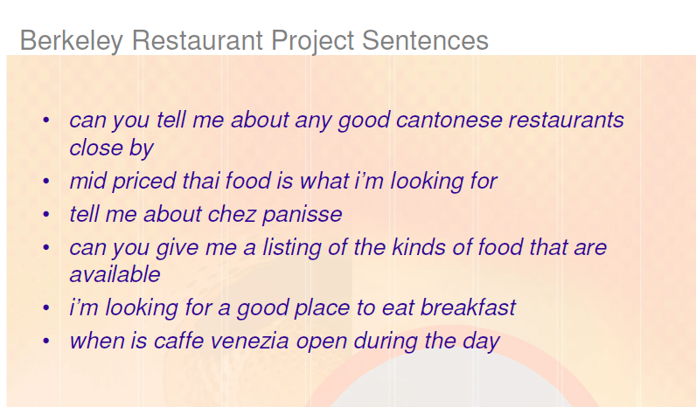
SIMPLE (UNSMOOTHED) N -GRAMS
A dialogue system that answered questions about a database of restaurants in Berkeley, California (Jurafsky et al., 1994).
Some sample user queries, lowercased and with no punctuation (a representative corpus of 9222 sentences is on the website):

Slide 49
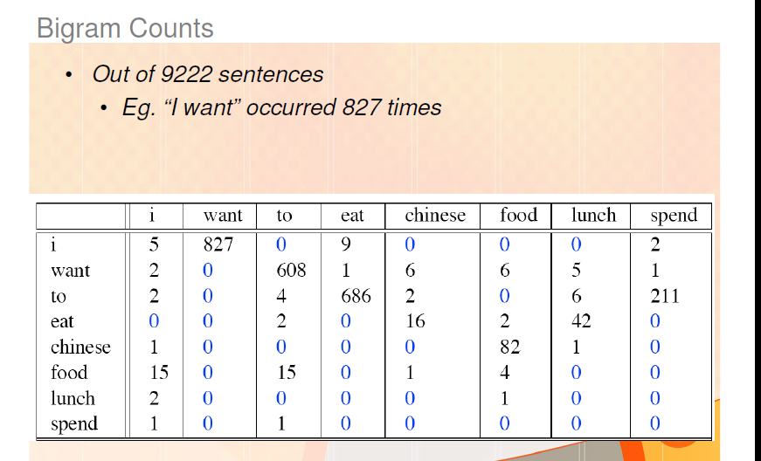
SIMPLE (UNSMOOTHED) N -GRAMS
Bigram count for 8 words V=1446 total word types
Note that the majority of the values are zero
The sample words are chosen to cohere with each other
A matrix selected from a random set of 7 words would be even more sparse

Slide 50
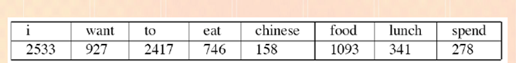
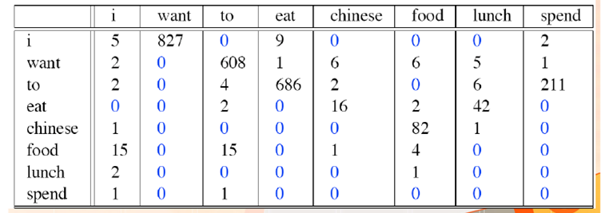
SIMPLE (UNSMOOTHED) N -GRAMS
Compute bigram probabilities for BRPS (Berkeley Restaurant Project Sentences) Corpus
Unigram count
Bigram counts

Slide 51
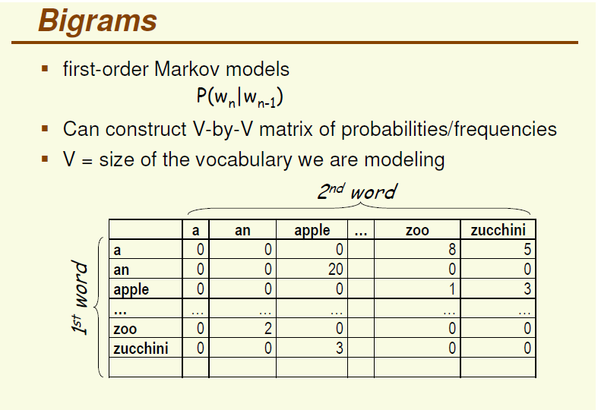
Bigram model
Given Count of 1 st word followed by 2nd word = C ( 1 st word, 2nd word)
Find Probability of 2nd word given 1st word = P ( 2nd word| 1st word)
P ( 2nd word| 1st word) = C ( 1 st word, 2nd word) / C( 1st word)

Slide 52
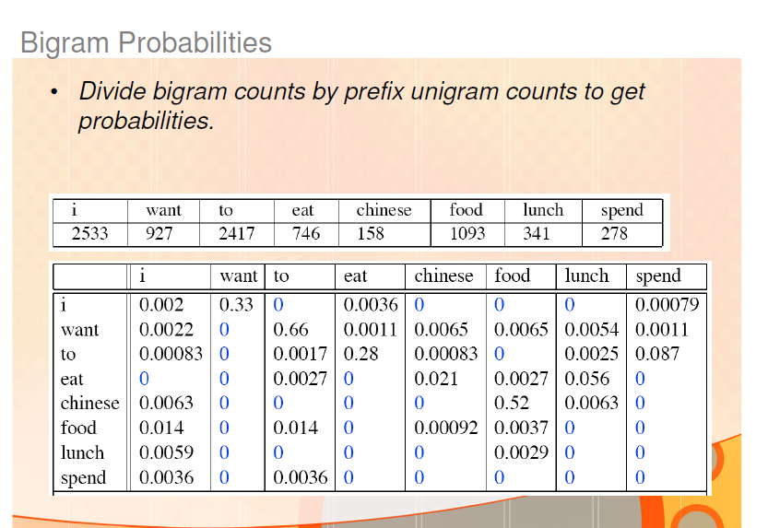
SIMPLE (UNSMOOTHED) N -GRAMS
Computing bigram probabilities for first row whose first word is i and second word is listed column wise.
P( i | i) = C( i , i) / C (i) = 5/2533= 0.002 P(want | i ) = C( i, want) / C (i) = 827/2533= 0.326
P(to | i ) = C( i, to) / C (i) = 0/2533= 0 P(eat | i ) = C( i, eat) / C (i) = 9/2533= 0.00355

Slide 53
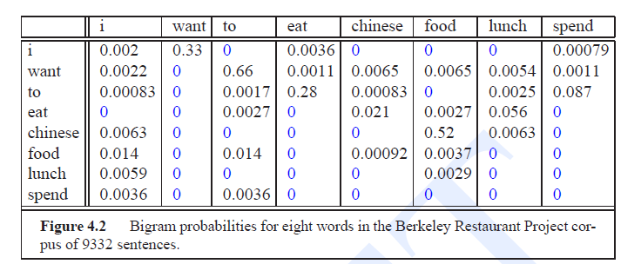
SIMPLE (UNSMOOTHED) N -GRAMS
Ex1: Compute the probability of sentence
I want English food
Consider following additional probability values:
P(i|<s>) = 0.25
P(english|want) = 0.0011
P(food|english) = 0.5
P(</s>|food) = 0.68

Slide 54
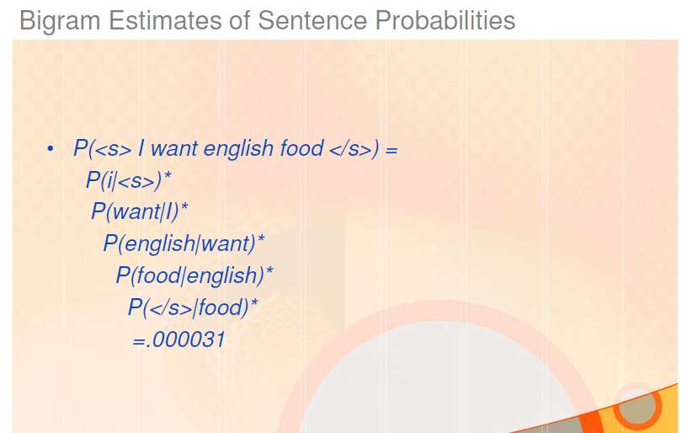
SIMPLE (UNSMOOTHED) N -GRAMS

Slide 55
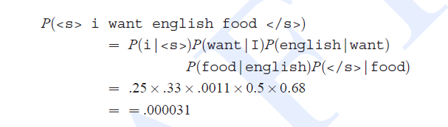
SIMPLE (UNSMOOTHED) N -GRAMS
Ex1: Compute the probability of sentence
I want English food
P(i|<s>) = 0.25
P(english|want) = 0.0011
P(food|english) = 0.5
P(</s>|food) = 0.68

Slide 56
SIMPLE (UNSMOOTHED) N -GRAMS
Ex2: compute the probability of sentence
I want Chinese food
P(i|<s>) = 0.25
P(english|want) = 0.0011
P(food|english) = 0.5
P(</s>|food) = 0.68

Slide 57
SIMPLE (UNSMOOTHED) N -GRAMS
Ex3: compute the probability of sentence
I want to eat Chinese food
P(i|<s>) = 0.25
P(english|want) = 0.0011
P(food|english) = 0.5
P(</s>|food) = 0.68
P(I want to eat Chinese food) ≈
P(I|<s>) * P(want|I) * P(to|want) * P(eat|to) * P(Chinese|eat) * P(food|Chinese)* P(</s>|food)
=

Slide 58
SIMPLE (UNSMOOTHED) N -GRAMS
Ex3: compute the probability of sentence
I want to eat Chinese food
P(i|<s>) = 0.25
P(english|want) = 0.0011
P(food|english) = 0.5
P(</s>|food) = 0.68
P(I want to eat Chinese food) ≈
P(I|<s>) * P(want|I) * P(to|want) * P(eat|to) * P(Chinese|eat) * P(food|Chinese)* P(</s>|food)
= .25 * .33 * .66 * .28 * .021 * .52 *0.68
= .000016

Slide 59
SIMPLE (UNSMOOTHED) N -GRAMS
What kinds of linguistic phenomena are captured in bigrams?
Some of the bigram probabilities encode facts that we think of as strictly syntactic in nature
like the fact that what comes after eat is usually a noun or an adjective
or that what comes after to is usually a verb

Slide 60
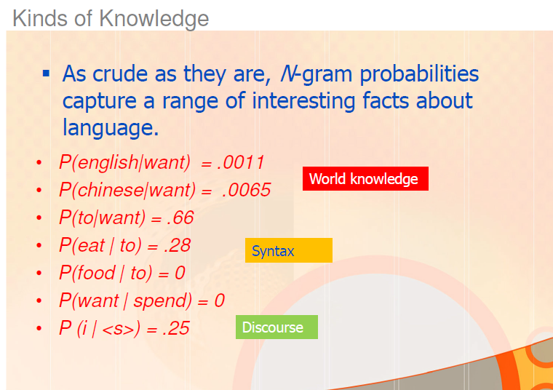
SIMPLE (UNSMOOTHED) N -GRAMS

Slide 61
Human Word Prediction
Clearly, at least some of us have the ability to predict future words in an utterance
How?
Domain knowledge
Syntactic knowledge
Lexical knowledge

Slide 62
SIMPLE (UNSMOOTHED) N -GRAMS
Bigram models were considered for Pedagogical purposes
when there is sufficient training data we are more likely to use trigram models
which condition on the previous two words rather than the previous word.
To compute trigram probabilities at the very beginning of sentence, we can use two pseudo-words for the first trigram (i.e., P(I|<s><s>)

Slide 63
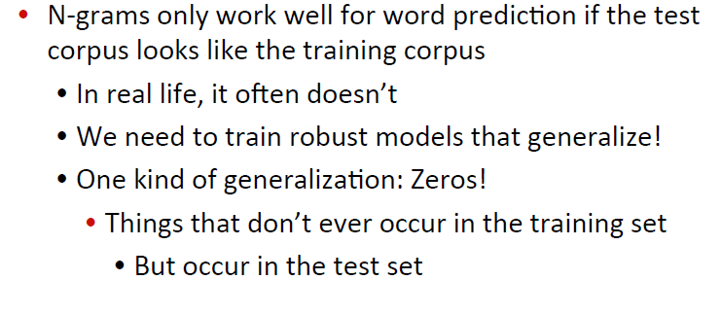
SIMPLE (UNSMOOTHED) N -GRAMS

Slide 64
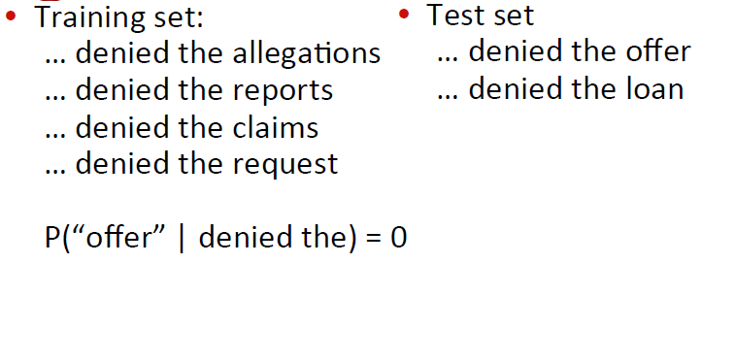
SIMPLE (UNSMOOTHED) N -GRAMS
Bigrams with zero probability mean that
we will assign 0 probability to the test set!

Slide 65
Training and Test sets
Probabilities come from a training corpus, which is used to design the model.
narrow corpus: probabilities don't generalize
general corpus: probabilities don't reflect task or domain
A separate test corpus is used to evaluate the model, typically using standard metrics
evaluation differences should be statistically significant

Slide 66
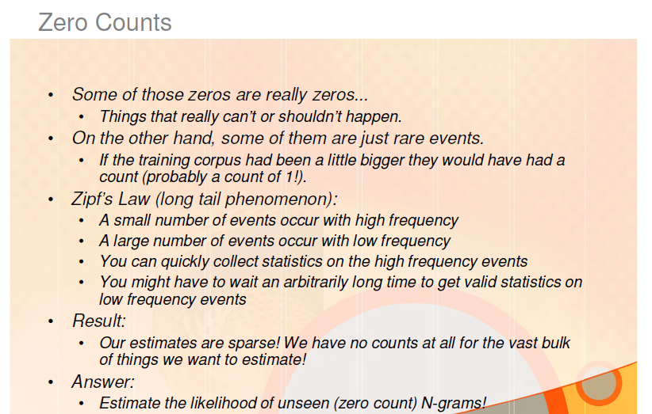
Smoothing

Slide 67
Smoothing
Major problem with the maximum likelihood estimation process we have seen for training the parameters of an N-gram model
The problem of sparse data
our maximum likelihood estimate was based on a particular set of training data.
For any N-gram that occurred a sufficient number of times, we might have a good estimate of its probability
But because any corpus is limited, some perfectly acceptable English word sequences are bound to be missing from it
This missing data means that the N-gram matrix for any given training corpus is bound to have a very large number of cases of putative “zero probability N-grams” that should really have some non-zero probability.
Furthermore, the MLE method also produces poor estimates when the counts are non-zero but still small

Slide 68
Smoothing
Need a method which can help get better estimates for these zero or low frequency counts
Zero counts turn out to cause another huge problem
The perplexity metric defined requires that we compute the probability of each test sentence
But if a test sentence has an N-gram that never appeared in the training set,
the Maximum Likelihood estimate of the probability for this N-gram and
for the whole test sentence, will be zero!
So to evaluate our language models,
we need to modify the MLE method
to assign some non-zero probability to any N-gram
even one that was never observed in training

Slide 69
Smoothing
Smoothing
modify the maximum likelihood estimates for computing N-gram probabilities
focusing on the N-gram events that we incorrectly assumed had zero probability
We use the term smoothing for such modifications that address the poor estimates that are due to variability in small data sets.
The name comes from the fact that we will be shaving a little bit of probability mass from the higher counts and
piling it instead on the zero counts making the distribution less jagged

Slide 70
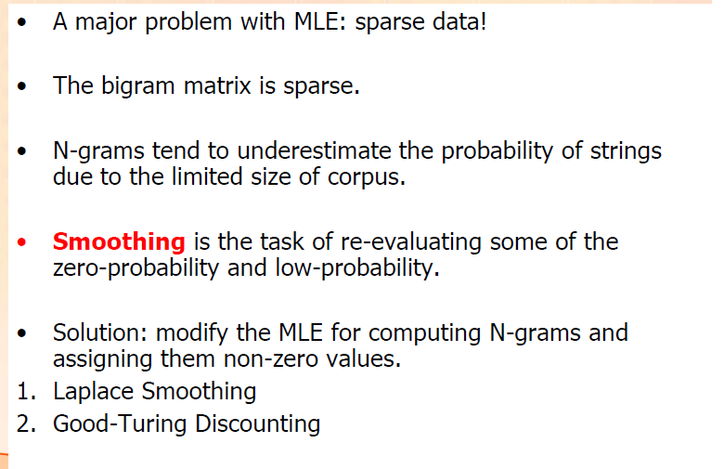
Smoothing

Slide 71
Smoothing
Background
Types: number of distinct words in a corpus (vocabulary size = V)
Tokens: total number of words = N, no punctuation etc.

Slide 72
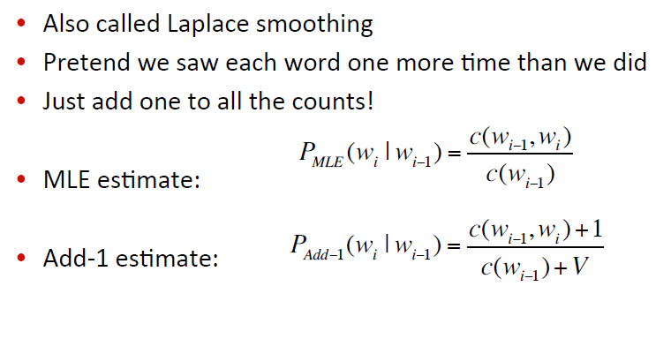
Laplace Smoothing
Adding1 to every count makes it never zero. To balance this, add the number of possible words to the divisor, so the division will never be greater than 1

Slide 73
Laplace Smoothing

Slide 74
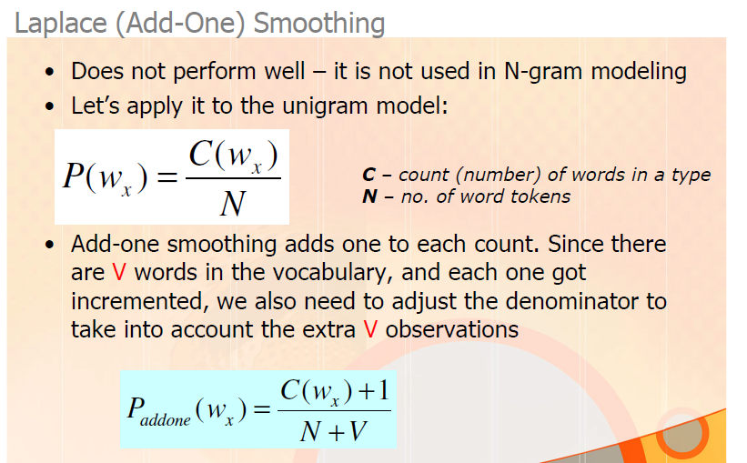
Laplace Smoothing
N – total number of tokens
V- total number of unique word types (Vocabulary size)

Slide 75
Laplace Smoothing
Simple way to do smoothing
take our matrix of bigram counts, before we normalize them into probabilities
and add one to all the counts.
This algorithm is called Laplace smoothing, or Laplace's Law

Slide 76
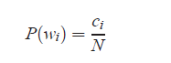
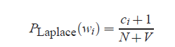
Laplace Smoothing
Application of Laplace smoothing to unigram probabilities:
Background:
the unsmoothed maximum likelihood estimate of the unigram probability of the word wi
is its count ci normalized by the total number of word tokens N
Since there are V words in the vocabulary, and each one got incremented,
we also need to adjust the denominator to take into account the extra V observations.

Slide 77
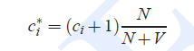
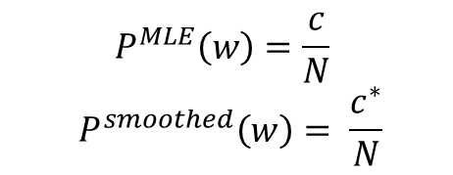
Laplace Smoothing
Define an adjusted count c*:
since we are only changing the numerator, in addition to adding one we will also need to
multiply by a normalization factor N/(N+V) : Unigram version
This adjusted count can be turned into a probability by normalizing by N.
$$P^{MLE}\left(w\right)=\frac{c}{N}$$
$$P^{smoothed}\left(w\right)= \frac{c^{∗}}{N}$$

Slide 78
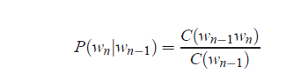
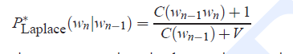
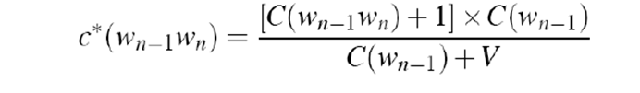
Unsmoothed & Laplace Smoothing – Summary of Bigram version
Get C* - To calculate the counts that we should have seen, in order to get the same probabilities as Add-1 smoothing

Slide 79
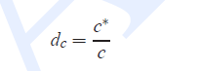
Laplace Smoothing
A related way to view smoothing is discounting (lowering):
lowering some non-zero counts in order to get the probability mass that will be assigned to the zero counts.
Instead of referring to the discounted counts c
describe a smoothing algorithm in terms of a relative discount
dc, the ratio of the discounted counts to the original counts

Slide 80
Laplace Smoothing
Recall that normal bigram probabilities are computed by normalizing each row of counts by the unigram count
For add-one smoothed bigram counts we need to augment the unigram count by the number of total word types in the vocabulary V:
Trigram version: P Laplace (w3 | w1,w2) = (c(w1,w2,w3) + 1) / (c(w1,w2) +V)

Slide 81
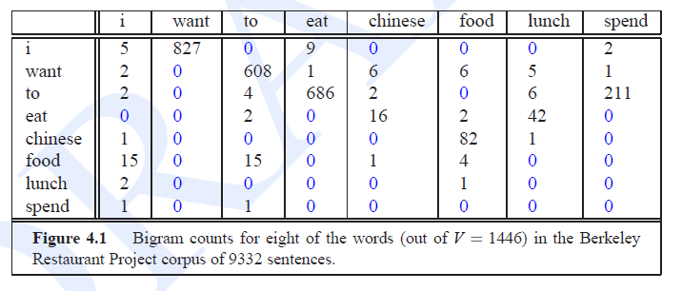
Berkeley Restaurant Corpus - Laplace Smoothed Bigram Counts
Compute Laplace smoothed bigram count for a given BeRP corpus:

Slide 82
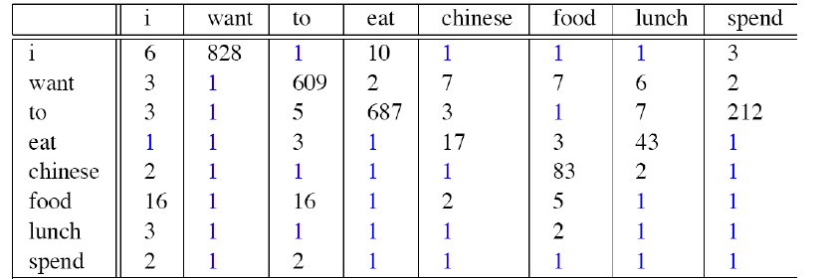
Berkeley Restaurant Corpus - Laplace Smoothed Bigram Counts
After computing Laplace smoothed bigram count for a given BeRP corpus:

Slide 83
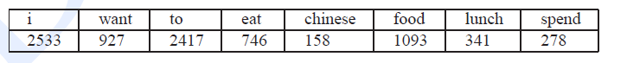
Berkeley Restaurant Corpus - Laplace Smoothed Bigram Counts
Compute Laplace smoothed bigram Probabilities from a given Laplace smoothed bigram count of BeRP corpus:
V = 1446

Slide 84
Laplace Smoothed Bigram probabilities
We need to add V (= 1446) to each of the unigram counts
The value of N for different words is as per table below
i 2533 +1446 = 3979
want 927+1446= 2373
to 2417+ 1446 =
eat 746+ 1446 =
chinese 158 + 1446 =
food 1093+ 1446 =
lunch 341+ 1446 =
spend 278+1446 =
Computing bigram probabilities for first row whose first word is i and second word is listed column wise.
P( i | i) = C( i) / N+V = 6/(2533 +1446) = 6/3979 = 0.0015 (Note :MLE P = 5/2533 = C/N)
P(want | i ) = C( i) / N+V = 828/(2533 +1446) = 0.208
P(to | i ) = C( i) / N+V = 1/(2533 +1446) =1/3979 = 0.00025
P(eat | i ) = C( i) / N+V = 10/3979= 0.0025

Slide 85
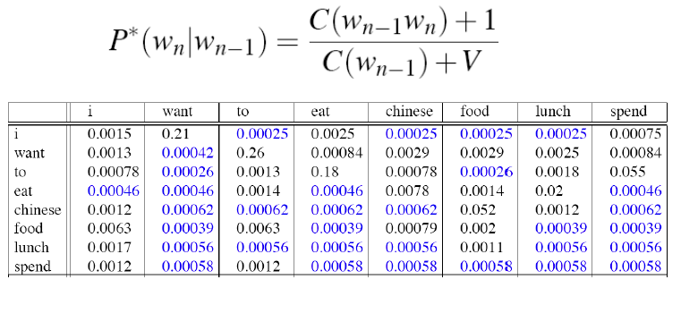
Berkeley Restaurant Corpus - Laplace Smoothed Bigram probabilities
Computing bigram probabilities for second row whose first word is want and second word is listed column wise.
P( i | want) = C( want) / N+V = 3/2373 = 0.00126
P(want | want ) = C( want) / N+V = 1/2373= 0.00042
P(to | want ) = C(want) / N+V = 609/2373= 0.256
P(eat | want ) = C( want) / N+V = 2/2373= 0.00084

Slide 86
Berkeley Restaurant Corpus - Laplace Smoothed Bigram Counts
Compute reconstituted count from a given Add-one smoothed bigram count of BeRP corpus:
V = 1446

Slide 87
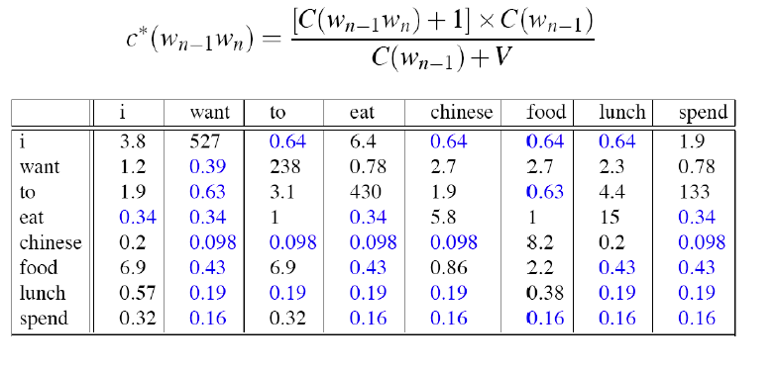
Berkeley Restaurant Corpus - Laplace Smoothed Bigram Counts

Slide 88
Berkeley Restaurant Corpus - Laplace Smoothed Bigram Counts
Computing C[i, i] =(5+1) * 2533 /(2533 + 1446 ) = 6* 2533/ 3979 = 3.8
Computing C[want, i] =(2+1) * 927 /(927 + 1446 ) = 3* 927/ 2373 = 1.17

Slide 89
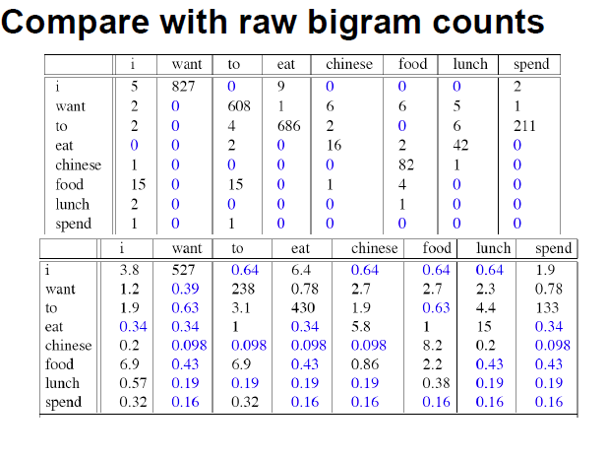
Berkeley Restaurant Corpus - Laplace Smoothed Bigram Counts
It is convenient to reconstruct the count matrix so we can see how much a
smoothing algorithm has changed the original counts.
C[want, to] = 608 to 238
d(want to) = C*/C= 238/608 = 0.39
d(chinese food) = 8.2/82 = 0.1

Slide 90
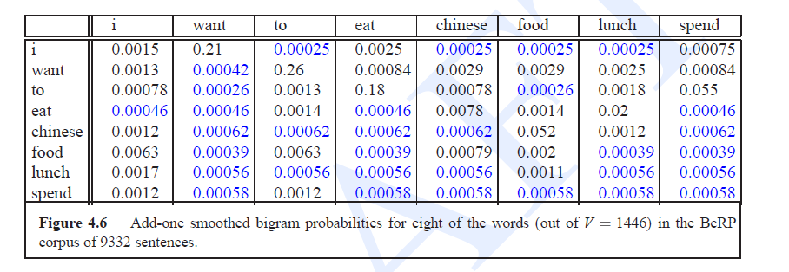
Berkeley Restaurant Corpus - Laplace Smoothed Bigram Counts – Compare with Probabilities
P( to| want) = 0.66 to 0.26

Slide 91
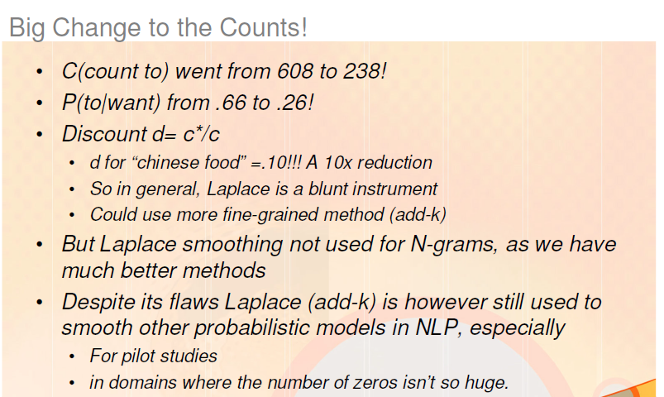
Laplace Smoothing
Note the correction : C(want to) in the first sentence

Slide 92
SIMPLE (UNSMOOTHED) N -GRAMS
Bigram count for 8 words V=1446 total word types
Note that the majority of the values are zero
The sample words are chosen to cohere with each other
A matrix selected from a random set of 7 words would be even more sparse

Slide 93
SIMPLE (UNSMOOTHED) N -GRAMS
Computing bigram probabilities for first row whose first word is i and second word is listed column wise.
P( i | i) = C( i , i) / C (i) = 5/2533= 0.002 P(want | i ) = C( i, want) / C (i) = 827/2533= 0.326
P(to | i ) = C( i, to) / C (i) = 0/2533= 0 P(eat | i ) = C( i, eat) / C (i) = 9/2533= 0.00355

Slide 94
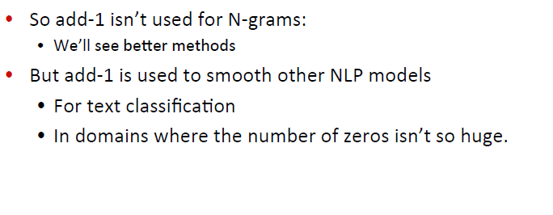
Laplace Smoothing
Add -1 estimation is a blunt instrument

Slide 95
SIMPLE (UNSMOOTHED) N -GRAMS
Bigrams with zero probability mean that
we will assign 0 probability to the test set!

Slide 96


The intuition of Smoothing (By Dan Klein)

Slide 97

Laplace Smoothing
The sharp change in counts and probabilities occurs
because too much probability mass is moved to all the zeros.
We could move a bit less mass by adding a fractional count rather than 1
add-k smoothing
requires a method for choosing k dynamically
Results in an inappropriate discount for many counts
and turns out to give counts with poor variances.
So we need better smoothing methods for N-grams

Slide 98
Add-k Smoothing
Add-k smoothing

Slide 99


Slide 100

Other Smoothing techniques

Slide 101

Good-Turing Smoothing
A word or N-gram (or any event) that occurs once is called a
singleton, or a hapax legomenon.
The Good-Turing intuition is to use the frequency of singletons as a re-estimate of the frequency of zero-count bigrams.
The Good-Turing algorithm is based on computing Nc, the number of N-grams that occur c times.
We refer to the number of N-grams that occur c times as the frequency of frequency c.
So applying the idea to smoothing the joint probability of bigrams
N0 is the number of bigrams with count 0,
N1 the number of bigrams with count 1 (singletons), and so on.
We can think of each of the Nc as a bin which stores the number of different N-grams that occur in the training set with that frequency c.

Slide 102

Good-Turing Smoothing
Notation
Nc = Frequency of frequency c

Slide 103
Good-Turing Smoothing
Notation
Nc = Frequency of frequency c

Slide 104
Good-Turing Smoothing
Notation
Nc = Frequency of frequency c

Slide 105
MLE vs. Good-Turing Smoothing

Slide 106


Good-Turing Smoothing
The MLE count for Nc is c.
The Good-Turing estimate replaces this with a smoothed count c*, as a function of Nc+1
To re-estimate the smoothed count c* for N0, use the following equation for the probability P*GT for things that had zero count N0, or for the missing mass:
N1 is the count of items in bin 1, i.e. that were seen once in training
N is the total number of items we have seen in training.

Slide 107

Good-Turing Smoothing
Suppose we are fishing in a lake with 8 species:
(bass, catfish, carp, perch, whitefish, trout, salmon, eel)
we have seen 6 species with the following counts:
10 carp, 3 perch, 2 whitefish, 1 trout, 1 salmon, and 1 eel
Not yet seen the catfish or bass
N is the total number of items we have seen in training = 18
N1= 3, N2=1, N3= 1, N10=1
What is the probability that the next fish we catch will be a new species, i.e., one that had a zero frequency in our training set, i.e., in this case either a catfish or a bass?
The MLE count c of a hitherto-unseen species (bass or catfish) is 0.
the probability of a new fish being one of these unseen species is 3/18 , since N1 is 3 and N is 18:

Slide 108
Good-Turing Smoothing
10 carp, 3 perch, 2 whitefish, 1 trout, 1 salmon, and 1 eel,
0 bass, 0 catfish
What is the probability that the next fish will be another trout?
The MLE count for trout is 1,
so the MLE estimated probability is 1/18 .
But the Good-Turing estimate must be lower, since we just stole 3/18 of our probability mass to use on unseen events!
We need to discount the MLE probabilities for trout, perch, carp, etc.

Slide 109

Good-Turing Smoothing
10 carp, 3 perch, 2 whitefish, 1 trout, 1 salmon, and 1 eel
0 bass, 0 catfish
Summary of the revised counts c* and Good-Turing smoothed probabilities p* GT for species with count 0 (like bass or catfish) or count 1 (like trout, salmon, or eel) are as follows
N is the total number of items we have seen in training = 18
N1= 3, N2=1, N3= 1, N10=1
Note: c* computation is not there for unseen ie. for count 0

Slide 110
Good-Turing Smoothing
10 carp, 3 perch, 2 whitefish, 1 trout, 1 salmon, and 1 eel
0 bass, 0 catfish
Revised count c* for eel was discounted from c= 1.0 to c* =.67
Thus leaving some probability mass p* GT(unseen) = 3/18 = .17 for the catfish and bass
since we know there were 2 unknown species, the probability of the next fish being specifically a catfish is
p*GT(catfish) = (1/2) × (3/ 18) = .085

Slide 111
Good-Turing Smoothing
Notation
Nc = Frequency of frequency c

Slide 112

Good-Turing Smoothing

Slide 113
Problem
Consider Vocabulary as {a, b, c}
Consider Corpus: b a b a a c b c a c a c
Find list of possible bigrams
Find out count of seen (observed) and unseen (unobserved) bigrams and their frequencies using Good Turing

Slide 114
Problem
Consider Vocabulary as {a, b, c}
Consider Corpus: b a b a a c b c a c a c
List of possible bigrams {aa, ab, ac, ba, bb, bc, ca, cb, cc}
Find out count of seen (observed) and unseen (unobserved) bigrams and their frequencies using Good Turing

Slide 115
Problem
Consider Vocabulary as {a, b, c}
Consider Corpus: b a b a a c b c a c a c
List of possible bigrams {aa, ab, ac, ba, bb, bc, ca, cb, cc}
Find out count of seen (observed) and unseen (unobserved) bigrams and their frequencies
Seen bigrams: {ba, ab, ba, aa, ac, cb, bc, ca, ac, ca, ac}
Unseen bigrams: {bb, cc}
Find out frequency of frequencies Nc for all values of c and find N:

Slide 116
Problem
Consider Vocabulary as {a, b, c}
Consider Corpus: b a b a a c b c a c a c
List of possible bigrams {aa, ab, ac, ba, bb, bc, ca, cb, cc}
Find out count of seen (observed) and unseen (unobserved) bigrams and their frequencies
Seen bigrams: {ba, ab, ba, aa, ac, cb, bc, ca, ac, ca, ac}
Unseen bigrams: {bb, cc}
Find out frequency of frequencies Nc for all values of c and find N:
ab:1, aa:1, cb:1, bc:1, ba:2, ca:2, ac:3
N0= 2, N1=4, N2 = 2, N3=1, N=Total of “seen bigrams” = 11
Compute P*GT upto c=2

Slide 117
Problem
Consider Vocabulary as {a, b, c}
Consider Corpus: b a b a a c b c a c a c
List of possible bigrams {aa, ab, ac, ba, bb, bc, ca, cb, cc}
Find out count of seen (observed) and unseen (unobserved) bigrams and their frequencies
Seen bigrams: {ba, ab, ba, aa, ac, cb, bc, ca, ac, ca, ac}
Unseen bigrams: {bb, cc}
Find out frequency of frequencies Nc for all values of c and find N:
ab:1, aa:1, cb:1, bc:1, ba:2, ca:2, ac:3
N0= 2, N1=4, N2 = 2, N3=1, N=Total of “seen bigrams” = 11
Compute P*GT upto c=2
c = 0 : P*GT(bb) = P*GT(cc) = (N1/N)*(1/N0) = (4/11)*(1/2) = 2/11
c = 1: P*GT(ab) = P*GT(aa) = P*GT(cb) = P*GT(bc) =
(1+1)*(N2/N1)*(1/N) = 2*(2/4)*(1/11) = 1/11
c = 2: P*GT(ba) = P*GT(ca) = (2+1)* (N3/N2)*(1/N) = 3*(1/2)*(1/11) = 3/22
c= 3: P MLE(ac) = 3/11

Slide 118

Why Good Turing?

Slide 119
Probability mass in Good Turing for unseen events
Holds out Probability mass for unseen (novel) events
How much probability mass is reserved for unseen events in Good-Turing ?

Slide 120
Probability mass in Good Turing for unseen events
Holds out Probability mass for unseen (novel) events
How much probability mass is reserved for unseen events in Good-Turing ?
A total mass of N1/N is allocated to unseen events
Divided up evenly among the unseen events

Slide 121

Combining Estimators

Slide 122

Combining Estimators
Linear Interpolation - Solve the sparseness in a trigram model by mixing with bigram and unigram models

Slide 123

Backoff and Interpolation

Slide 124

Backoff and Interpolation

Slide 125
Interpolation
The discounting can help solve the problem of zero frequency N-grams.
But there is an additional source of knowledge to mitigate sparse data: N-gram “hierarchy”
If we are trying to compute P(wn|wn−1wn−2),
but we have no examples of a particular trigram wn−2 wn−1 wn,
we can instead estimate its probability by using the bigram probability P(wn|wn−1).
Similarly, if we do not have counts to compute P(wn|wn−1),
we can look to the unigram P(wn).

Slide 126
Interpolation
There are two ways to use this N-gram “hierarchy”
Backoff and interpolation
Backoff:
if we have non-zero trigram counts, rely solely on the trigram counts
only “back off” to a lower order N-gram if we have zero evidence for a higher-order N-gram
Interpolation: Simple and conditional Interpolation
mix the probability estimates from all the N-gram estimators,
Which is finding a weighted interpolation of trigram, bigram, and unigram counts

Slide 127

Interpolation
Simple linear interpolation:
we combine different order N-grams by linearly interpolating all the models.
To estimate the trigram probability P(wn|wn−1wn−2)
Mix together the unigram, bigram, and trigram probabilities, each weighted by a lambda

Slide 128

Interpolation

Slide 129
Interpolation
Conditional on context:
each weight is computed by conditioning on the context
if we have accurate counts for a particular bigram,
we assume that the counts of the trigrams based on this bigram will be more trustworthy
so we can make the lambdas for those trigrams higher and thus give that trigram more weight in the interpolation.

Slide 130
Backoff
Backoff N-gram modeling: Katz backoff
introduced by Katz (1987), hence backoff with discounting is also called Katz backoff
In a Katz backoff N-gram model, if the N-gram we need has zero counts
approximate it by backing off to the (N-1)-gram
continue backing off until we reach a history that has some counts

Slide 131
Backoff
Backoff N-gram modeling: Katz backoff

Slide 132
Training and Test data
The n gram model is good example of the statistical model in speech and language processing
The probabilities of an N-gram model come from the corpus it is trained on
The parameters of a statistical model are trained on some set of data
It can be applied to new data in some task (such as speech recognition) see to how well they work
new data or task will not be the exact same data trained on

Slide 133
Training and Test data
Training set and test set (training corpus and a test corpus)
Formal idea:
training on some data, and testing on some other data
Call two data sets as a training set and a test set (or a training
corpus and a test corpus)
using a statistical model of language given some corpus of relevant data
start by dividing the data into training and test sets
train the statistical parameters of the model on the training set
use this trained model to compute probabilities on the test set

Slide 134
Training and Test data
Training-and-testing paradigm can also be used to evaluate different N-gram models
Suppose we want to compare different language models
either based on N-grams of different orders N
or using the different smoothing algorithms
We can do this by taking a corpus and dividing it into a training set and a test set.
Then train the two different N-gram models on the training set and see which one better models the test set.
How to “model the test set”?
Perplexity : metric for how well a given statistical model matches a test corpus
is based on computing the probability of each sentence in the test set
intuitively, whichever model assigns a higher probability to the test set (hence more accurately predicts the test set) is a better model

Slide 135
Training and Test data
Training-and-testing paradigm can also be used to evaluate different N-gram models
Since our evaluation metric is based on test set probability
It Is important not to let the test sentences into the training set
Suppose we are trying to compute the probability of a “test” sentence.
If our test sentence is part of the training corpus,
We will mistakenly assign it an artificially high probability when it occurs in the test set
We call this situation training on the test set.
Training on the test set introduces a bias that makes the probabilities all look too high and causes huge inaccuracies in perplexity

Slide 136
Training and Test data
other divisions of data:
we need an extra source of data to augment the training set
Such extra data is called a held-out set
because we hold it out from our training set when we train our N-gram counts.
The held-out corpus is then used to set some other parameters
Ex : we can use held-out data to set interpolation weights in interpolated N-gram models
Finally, we need to have multiple test sets
we might use a particular test set so often that we implicitly tune to its characteristics
Then we need a fresh test set which is truly unseen.
In such cases, we call the initial test set the development test set or, devset

Slide 137
Training and Test data
How to divide data into training, dev and test sets?
There is a tradeoff
we want our test set to be as large as possible and a small test set may be accidentally unrepresentative.
we want as much training data as possible.
At the minimum, pick the smallest test set that gives statistical power to measure a statistically significant difference between two potential models
In practice, we divide our data into 80% training, 10% development, and 10% test.

Slide 138

Training and Test data

Slide 139
Evaluating N grams
Evaluating the performance of a language model:
The best way to evaluate the performance of a language model
embed it in an application and
measure the total performance of the application.
Such end-to-end evaluation is called extrinsic evaluation or in-vivo evaluation (Sparck Jones and Galliers, 1996)
Ex: Speech recognition
compare the performance of two language models by
run the speech recognizer twice, once with each language model, and
Find out which one gives the more accurate transcription

Slide 140
Evaluating N grams
Evaluating the performance of a language model:
Extrinsic evaluation or in-vivo evaluation (Sparck Jones and Galliers, 1996)
Ex: speech recognition
Problem with end to end evaluation ?

Slide 141
Evaluating N grams: Perplexity
Problem with end to end evaluation
end-to-end evaluation is very expensive
evaluating a large speech recognition test set takes hours or days
Need a metric that can be used to quickly evaluate potential improvements in a language model
An intrinsitic evaluation metric measures the quality of a model independent of any application.
Perplexity is the most common intrinsic evaluation metric for N-gram language models.
Note: an (intrinsic) improvement in perplexity
does not guarantee an (extrinsic) improvement in speech recognition performance (or any other end-to-end metric)
it correlates with such improvements

Slide 142
Evaluating N grams: Perplexity
Perplexity:
commonly used as a quick check on an algorithm
an improvement in perplexity can be confirmed by an end-to-end evaluation
Intuitive idea:
given two probabilistic models, which is the better model?
One that has a tighter fit to the test data, or predicts the details of the test data better
We can measure better prediction by looking at the probability the model assigns to the test data
Better model will assign a higher probability to the test data
The best language model is the one that best predicts unseen test set

